Slide 1
Innovative test solution provider

Slide 2
Contents
Corporate Overview
Core Value
Products
Corporate Vision

Slide 3
Corporate Overview
Company name
CEO
Establishment date
Location
: INNOVO SOLUTION. CO., LTD.
: Young-Jae Chung
: 13 Feb. 2007
: Head office & Factory
333-9, Sangdeawon1-dong,
Jung-won-Gu Seongnam-Si, Gyeonggido,
462- 807 ,Korea
Page 3

Slide 4
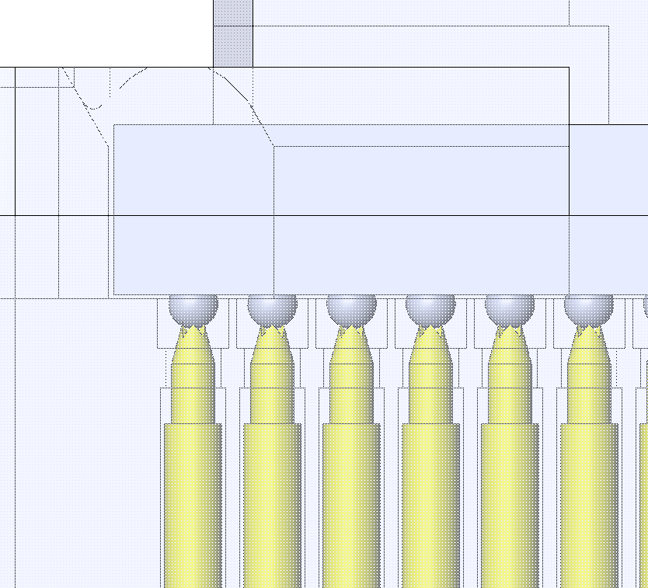
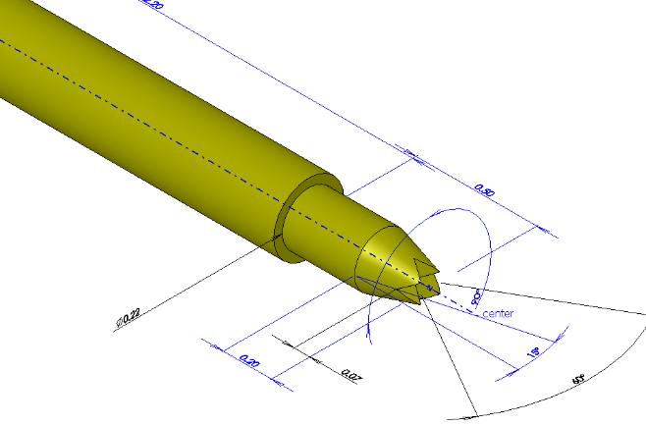
※ Core Value – Integrated test solution
- Integrated test solution (from probe pin to test socket)
  When started to design a Socket and Probe pin, our design team uses 3D design simulation system to analyze various aspects.
  Which can detect any field defect or problem.
Page 4

Slide 5
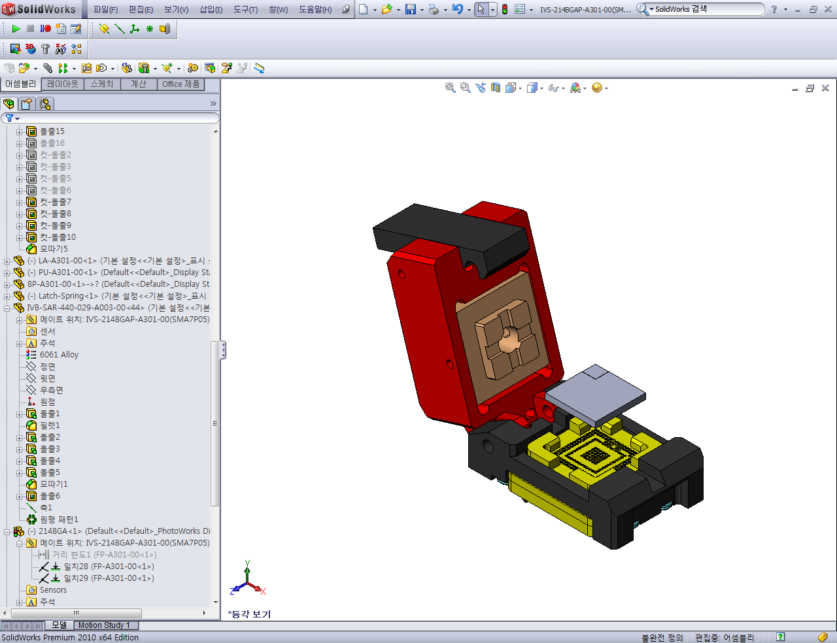
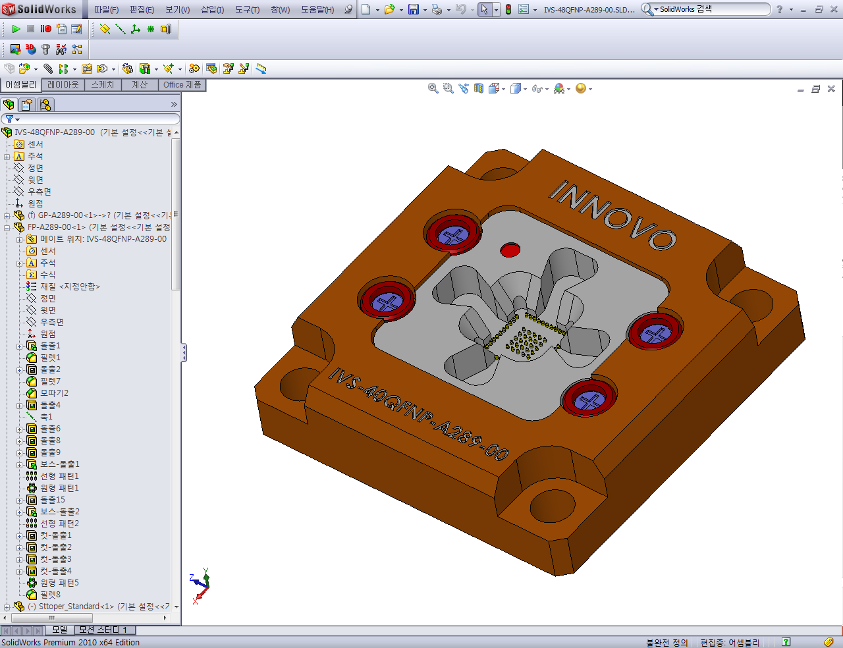
※ Core Value – Size optimization
- Size optimization
  → INNOVO provides the customized and optimized test socket depending on the size of IC.
  → This is able to give the best test condition.
Page 5

Slide 6
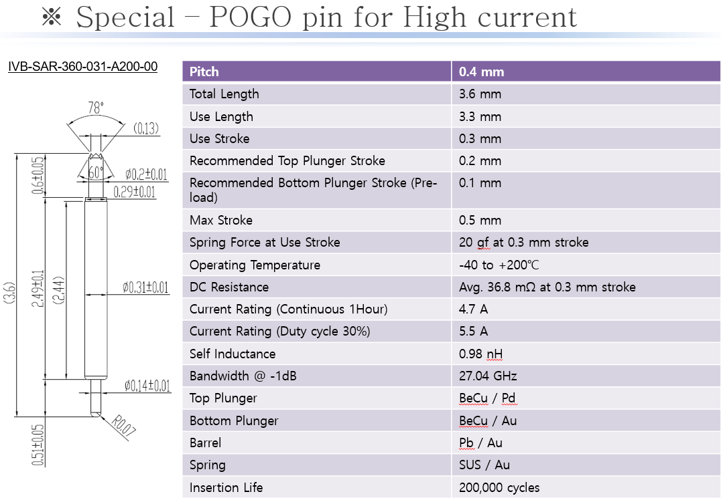
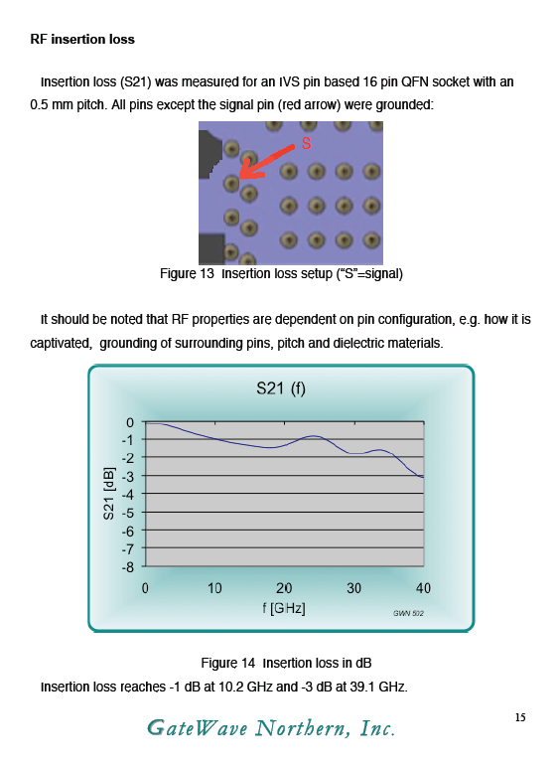
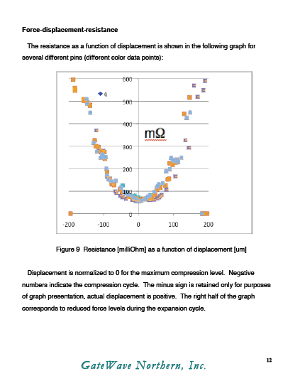
※ Core Value – High current test solution
- High current test solution
  → INNOVO has great experience about the field of power IC & PMIC.
  → Providing the stable test result, INNOVO’s socket conduct safely under the high current condition.
Page 6

Slide 7
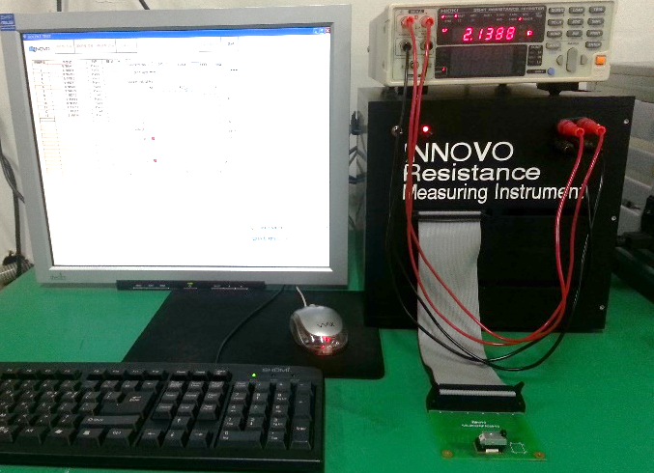
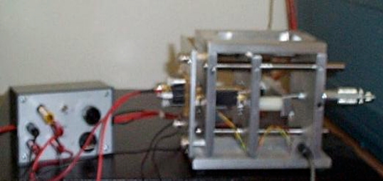
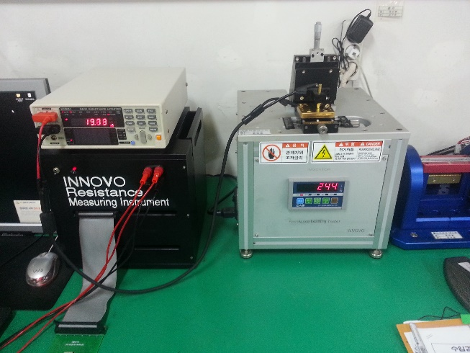
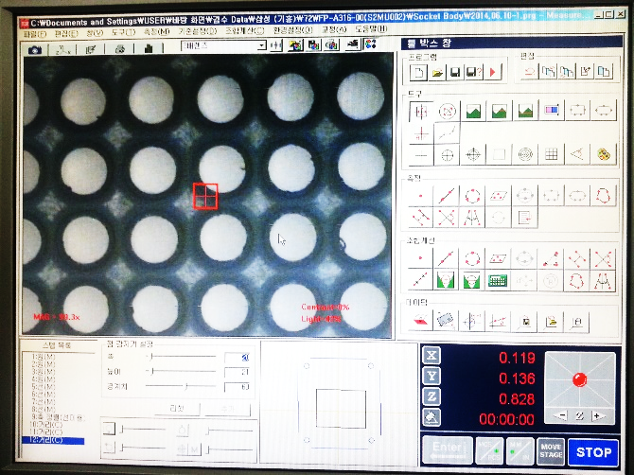
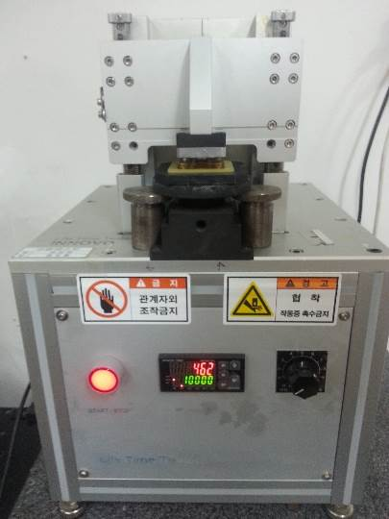
※ Core Value – Customized test machine
- Customized test machine
  → INNOVO has developed the customized test machine which is related with customer needs and condition.
  → Having a quality control system, INNOVO provides a highly reliable product to customer.
Page 7

Slide 8
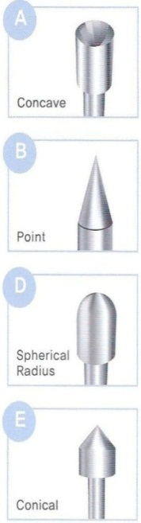
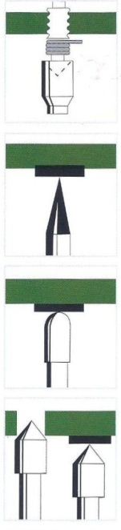
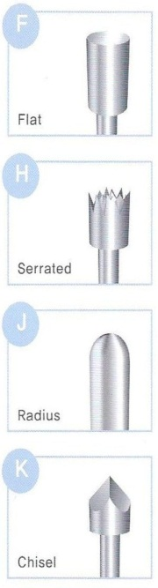
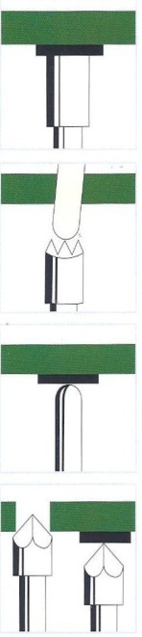
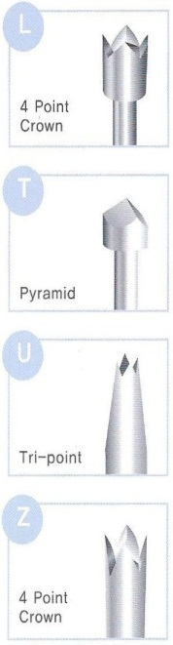

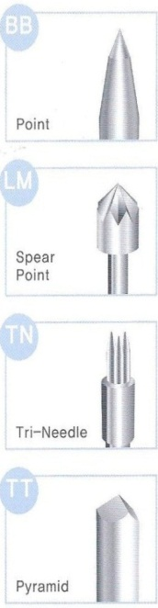
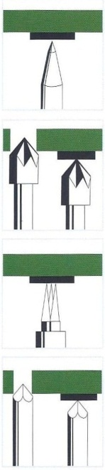
※ Products – Probe pin
General POGO pin
Special POGO pin (for High current & Low pitch)
Customized probe pin
Tip style & Application
Page 8

Slide 9
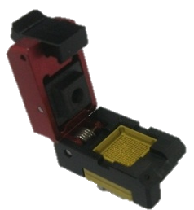
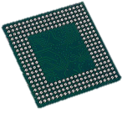
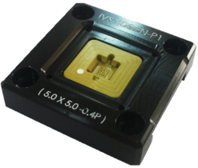
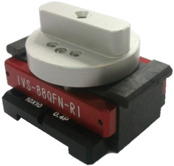
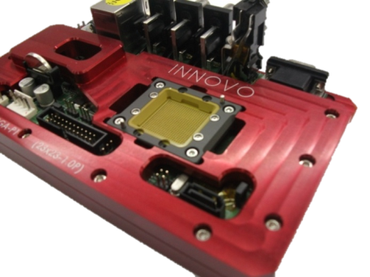
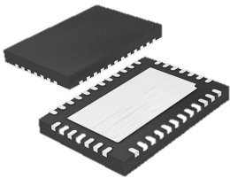
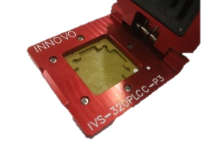
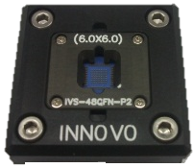
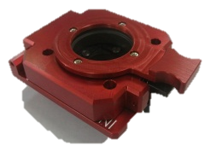
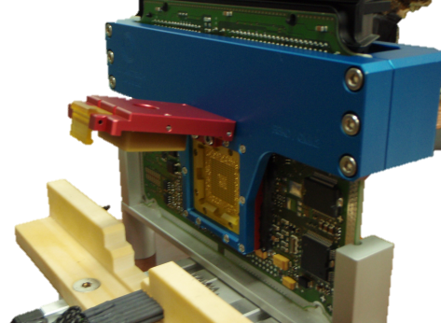
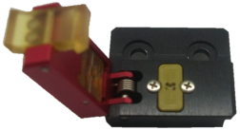
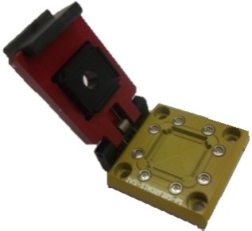
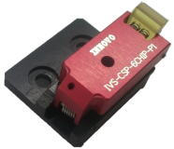
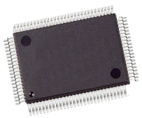

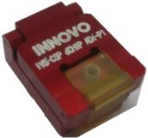
※ Products - Test socket & JIG Application
BGA
PCB test JIG
QFN
PLCC
WLCSP
QFP
ECU test JIG
Page 9

Slide 10
Corporate Vision
Customer
`
Quality
Price
Performance
Delivery
Novelty
Intelligence
Creativity
Innovation
Productivity
Originality
Novelty
Creativity
Productivity
Stability
Page 10

Slide 11
Thank you.
InnovoSolution Co., Ltd.
12, Galmachi-ro 203beon-gil, Jungwon-gu, Seongnam-si, Gyeonggi-do, Republic of Korea
Indy (SB) Chung .
Director .
Phone: +82-10-2850-9025
Fax: +82-31-735-6145 .

